Slide 1
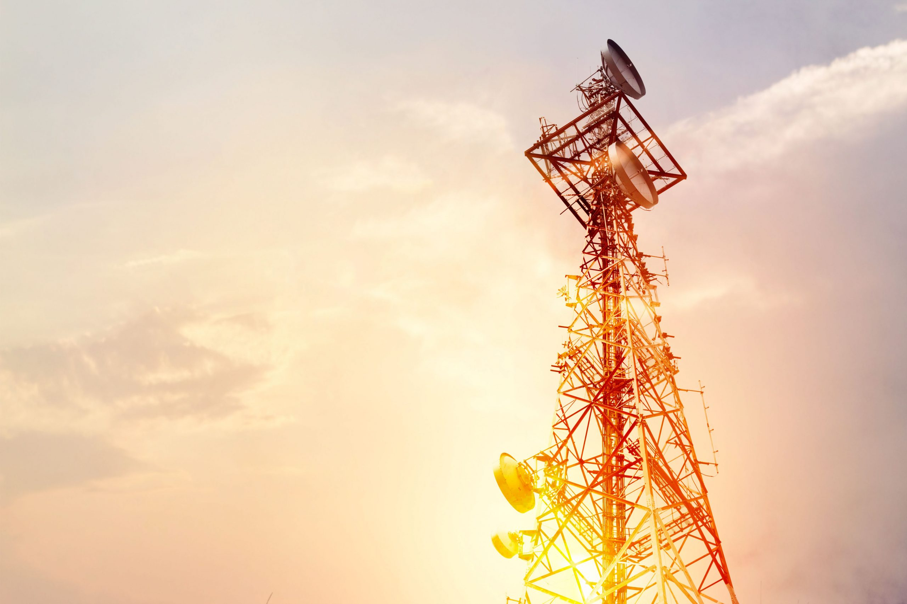

Northeast Region
Network-Sales Meeting
July 2026

Slide 2
Content
Data and Voice Traffic Behavior of Northeast Region
Capacity addition summary
Cluster Improvement Initiatives

Slide 3
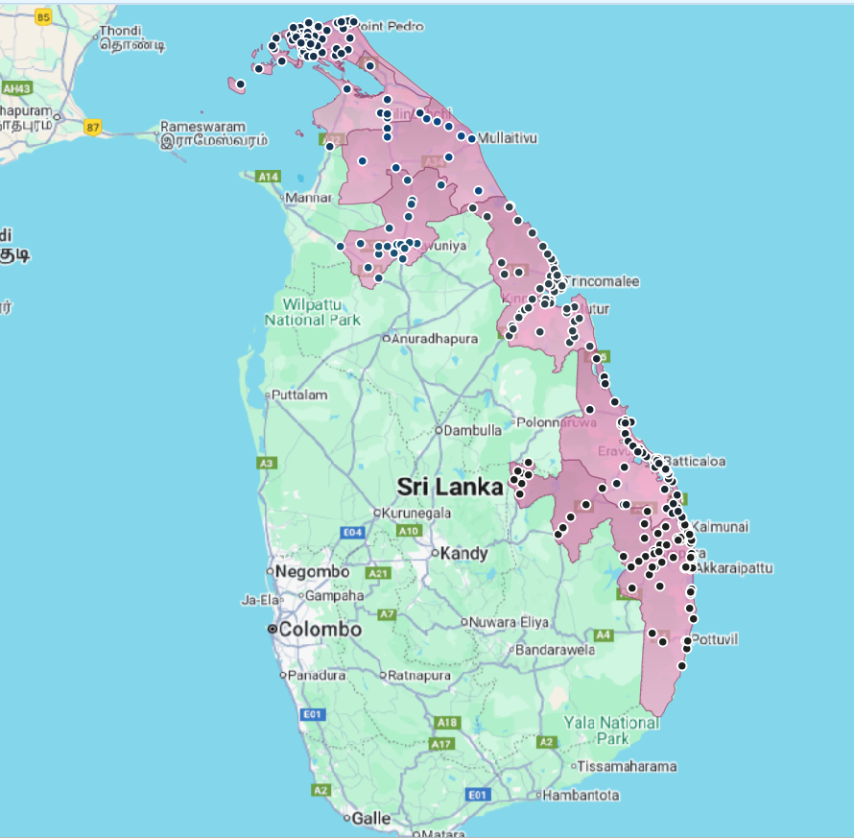
Distribution of Sites - NEA
Row Labels | Count of Sites
Ampara | 85
Batticaloa | 58
Jaffna | 63
Kilinochchi | 9
Mullaitivu | 10
Trincomalee | 58
Vavuniya | 22
Mannar | 18
Grand Total | 323

Slide 4
Data and Voice Traffic Behavior of Northeast Cluster – 2G Voice Traffic

Slide 5
Data and Voice Traffic Behavior of Northeast Cluster – 3G Voice Traffic

Slide 6
Data and Voice Traffic Behavior of Northeast Cluster – Total Voice Traffic (2G/3G)

Slide 7
Network VoLTE Traffic

Slide 8
Data Traffic Behavior of Northeast Cluster – 4G Data Traffic

Slide 9
Data and Voice Traffic Behavior of Northeast Cluster – 3G Data Traffic
3G remain Sites | Site ID | District
NamalOya-1 | AMP019 | AMP
ParanaMedawachchiya-1 | TRN013 | TRN
Pulmoddai-1 | TRN012 | TRN
Pulmoddai-2 | TRN029 | TRN
Punani-1 | BAT017 | BAT
Eastern cluster 3G shutdown – Oct 27

Slide 10
Data and Voice Traffic Behavior of Northeast Cluster – Total Data Traffic (3G/4G)

Slide 11
Data and Voice Traffic Improvement - 2026 January 2nd Week vs 2026 June 2nd Week
Data
Voice
VoLTE

Slide 12
Capacity Upgrades 2026 – Current status
Row Labels | Count of Site ID
AMP | 11
BAT | 10
JAF | 16
KIL | 2
MAN | 1
MUL | 1
TRN | 14
VAV | 7
Grand Total | 62
Row Labels | Count of Sector ID
AMP | 15
BAT | 15
JAF | 21
KIL | 3
MAN | 1
MUL | 1
TRN | 19
VAV | 8
Grand Total | 83

Slide 13
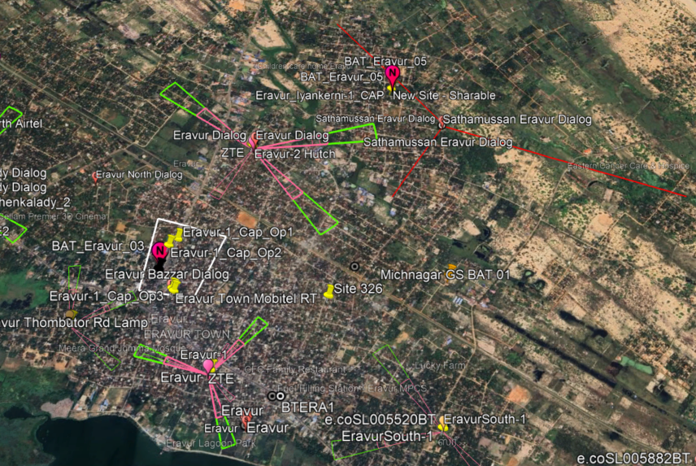
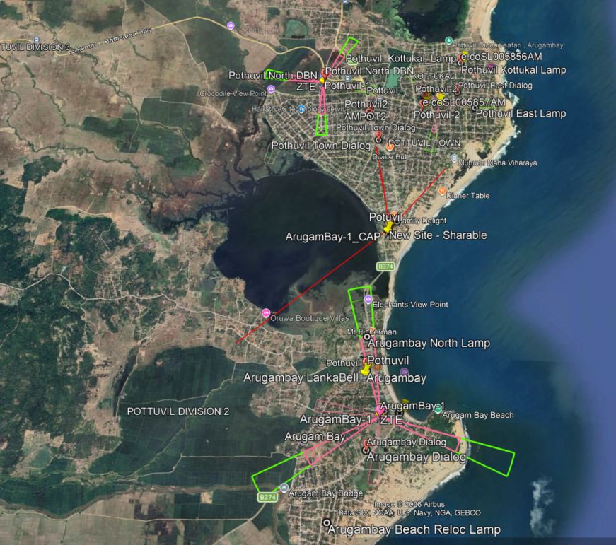
New sites – upcoming - > On-aired
Eravur-3 - BAT
Pothuvil-3 - AMP
Uhana 2 – AMP – ATP pending (Final stage)
Kohombana-1 - AMP
Batticaloa_VetharaniyamSt-1 relocate to Oddamavadi area - > Included to plans
KurunchakernySouth-1 – proceed for a 4th sector addition + Capacity upgrade - > Completed

Slide 14
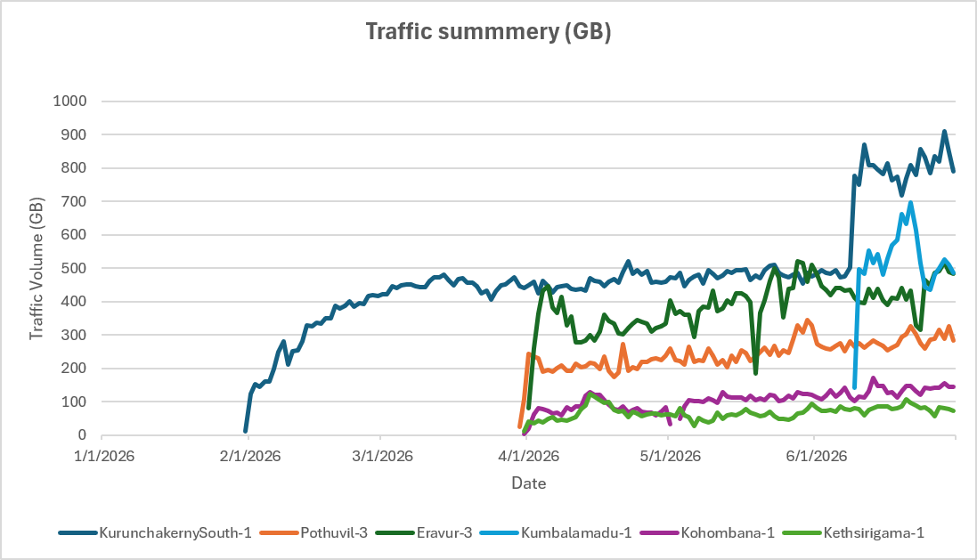
08 New sites
District | Site Name | Category
AMP | Kethsirigama-1 | Coverage
AMP | Kohombana-1 | Coverage
AMP | Pothuvil-3 | Capacity
AMP | Uhana-2 (ATP pending) | Coverage
BAT | Eravur-3 | Capcity
BAT | Kallaru-1 (Relocated to new GF) | Coverage
BAT | Kumbalamadu-1 | Capacity
BAT | Munaikkadu-1 (ATP pending) | Coverage
TRN | KurunchakernySouth-1 | GS
 | KurunchakernySouth-1 | Pothuvil-3 | Eravur-3 | Kumbalamadu-1 | Kohombana-1 | Kethsirigama-1 | Munaikkadu-1
Current Average Traffic (GB)/day | 832 | 293 | 490 | 483 | 144 | 74 | 122

Slide 15

Q & A

Slide 16
Thank You

